Slide 1
Machine Learning Strategies in Peer-to-Peer Lending
IST 707: Applied Machine Learning
December 9, 2021
Courtney Hrdy & Shannon Gambuti
Notes:
This project uses data mining and machine learning techniques used for prediction, classification, clustering, evaluation, and analysis.

Slide 2
Overview
LendingClub is a U.S.-based peer-to-peer lending company that provisions 3–5-year loans between $1,000 and $40,000 to accepted applicants based on a risk score calculation. The assigned risk score to all loan applicants determines whether a loan is accepted, and the interest rate the approved loans will receive.
The risk score that has been used requires evaluation and improvement, given the increase in defaulted and charged off loans. LendingClub is looking for a new proposed model that would help potentially assign a risk score to loan applicants.

Slide 3
LendingClub goes public and is worth more than $10 billion.
Defaulted loans surge, data released to the public for risk scoring.
CEO is fired and IPO drops to $8.
2006
2014
2015
2016
2018
CEO Renaud Laplanche launches Lending-Club as a Facebook application
Allen Griffin designs an algorithm to classify duplicate borrowers and starts data mining the Lending Club database. Realizes how bad things are
LendingCub data scientist is found to have falsified $22 million of loans sold to Jeffries and Goldman Sachs

Slide 4
The Data
Accepted Loans Dataset
253,629 records
107 attributes
Data Cleaning and Preprocessing Steps:
1. Removing null values:
Removed all rows with missing values – 39% of data
2. Converted percentages in interest rate column to decimals
3. Removed '<','+','year', 'years' from employment length column
4. Converted issue date from m-yy format to m-yyyy
5. Created new DataFrame with the following columns:
loan amount | interest rate | term | grade | employment length | issue date | month |loan status | payment plan | purpose | zip code | state | Debt-to-Income | delinquency | earliest credit line | open account | revolving balance | revolving utilization rate | total credit lines | application type
6. Merged new DataFrame with rejected dataset in Spark – joined on Class
After preprocessing: 235,629 records
Rejected Loans Dataset
16,384 records
9 attributes
7 common attributes:
Amount Requested, Month, Purpose, DBI Ratio, State, Years of Employment, class (reject/approve)
Target Variable: Charged off
LendingClub has given up on being repaid according to the original terms of the loan

Slide 5
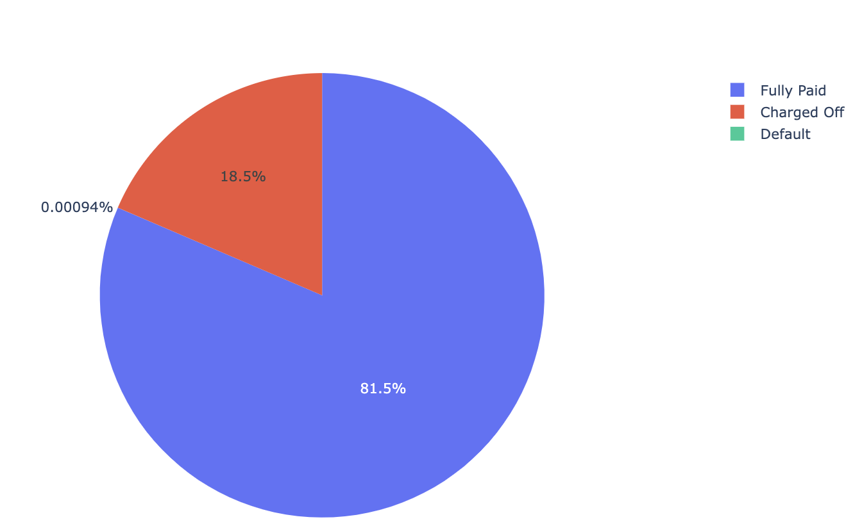
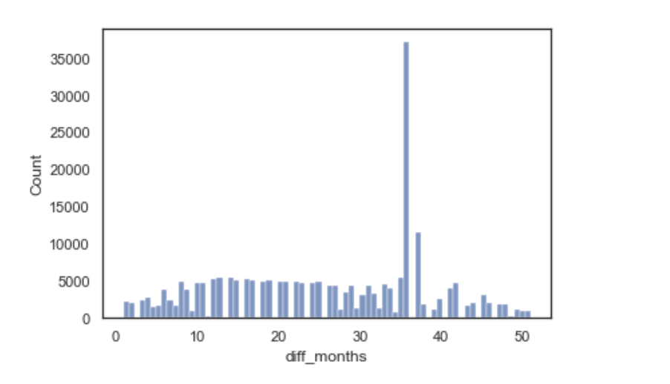
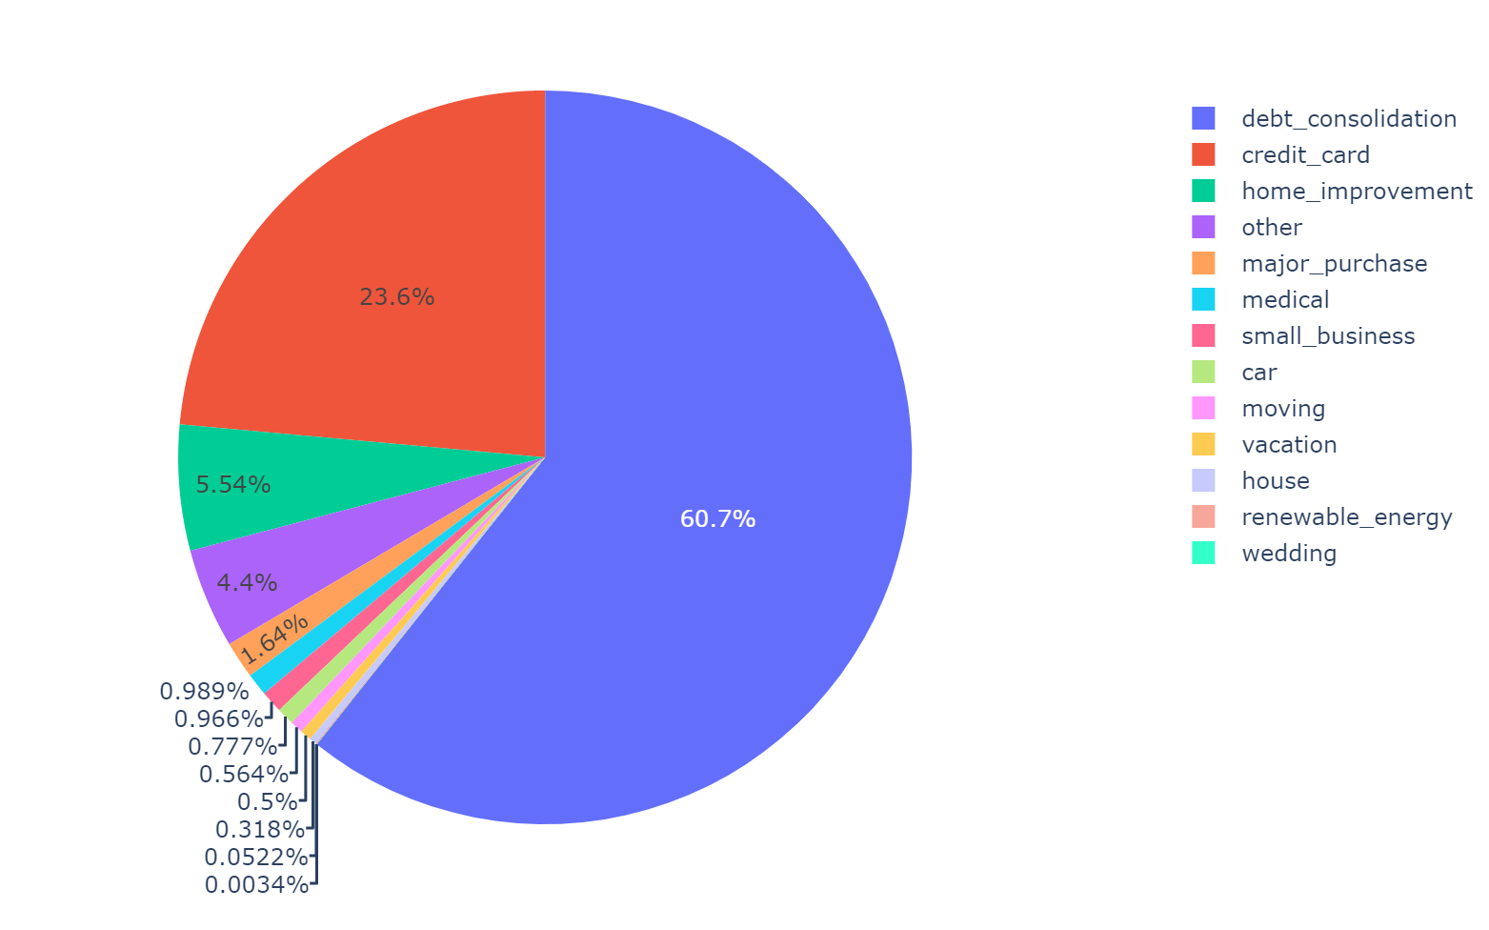
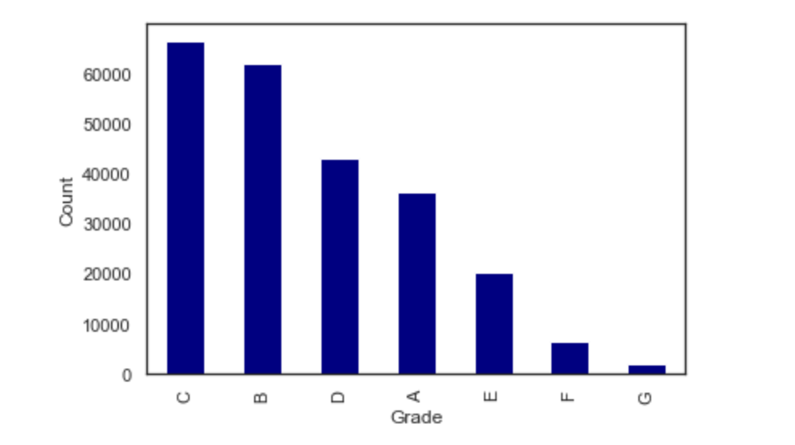
Exploratory Data Analysis
Loan Status
Frequency of Loan Duration
Loan Purpose
Distribution of Grades
Notes:
Loans were issued in 2014
Last payment dates range 2014 – 2018
Range from 28 days to 4 years
file:///Users/courtneyhrdy/Downloads/Lending_Club_Data_Analysis.pdf
https://skhan-tech.github.io/2020/02/16/Lending-Club-Loan-Analysis/

Slide 6
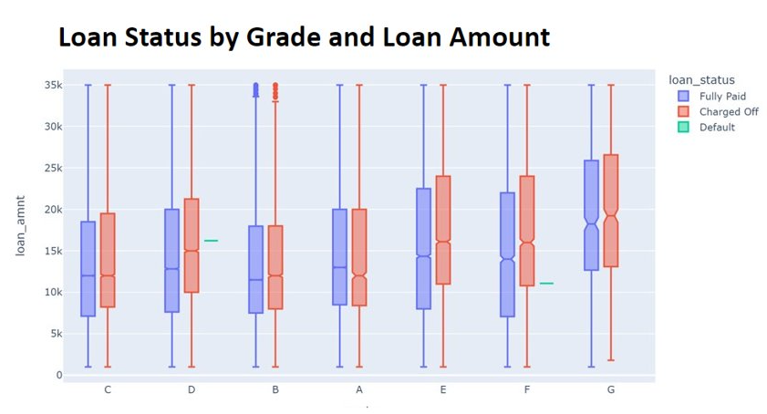
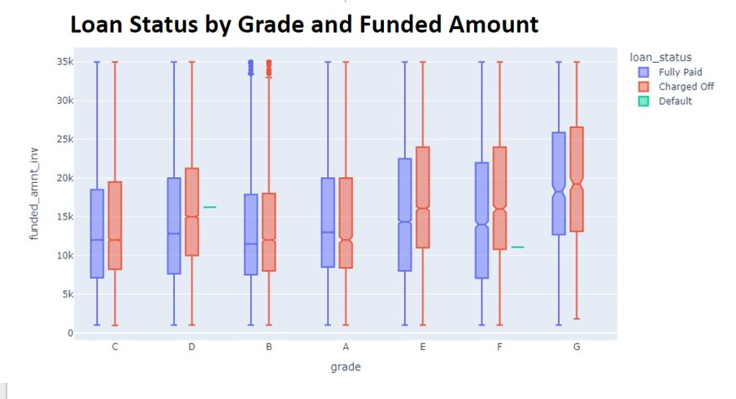
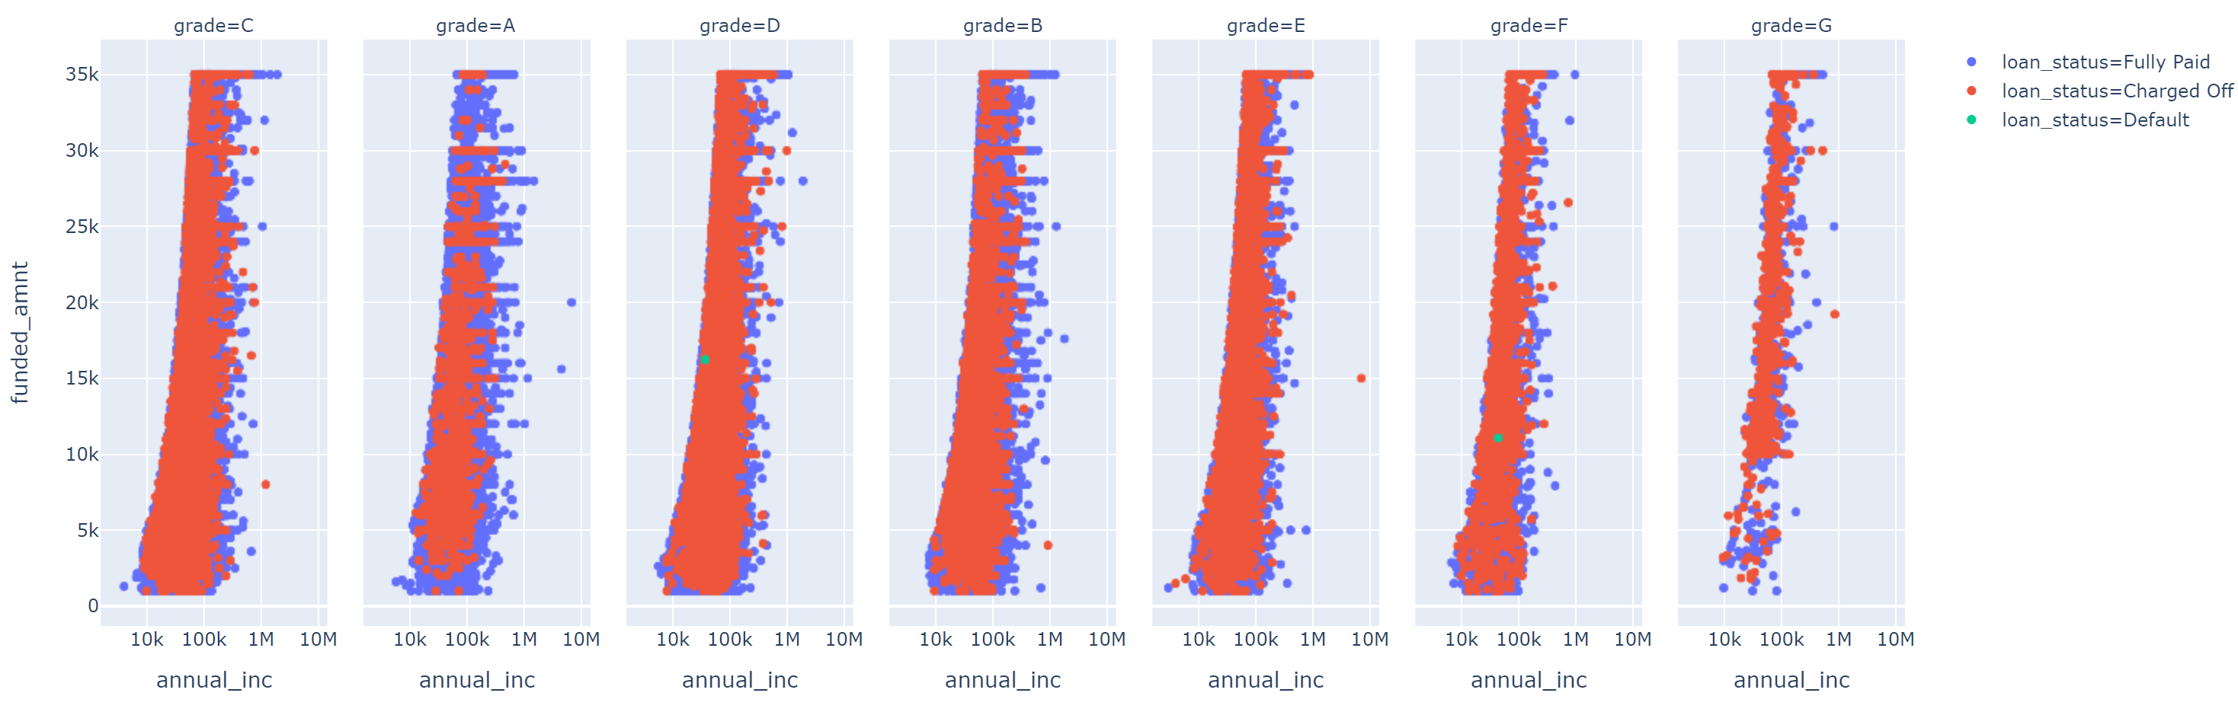
Exploratory Data Analysis
Funded Amount by Annual Income Broken Down by Grade and Loan Status

Slide 7
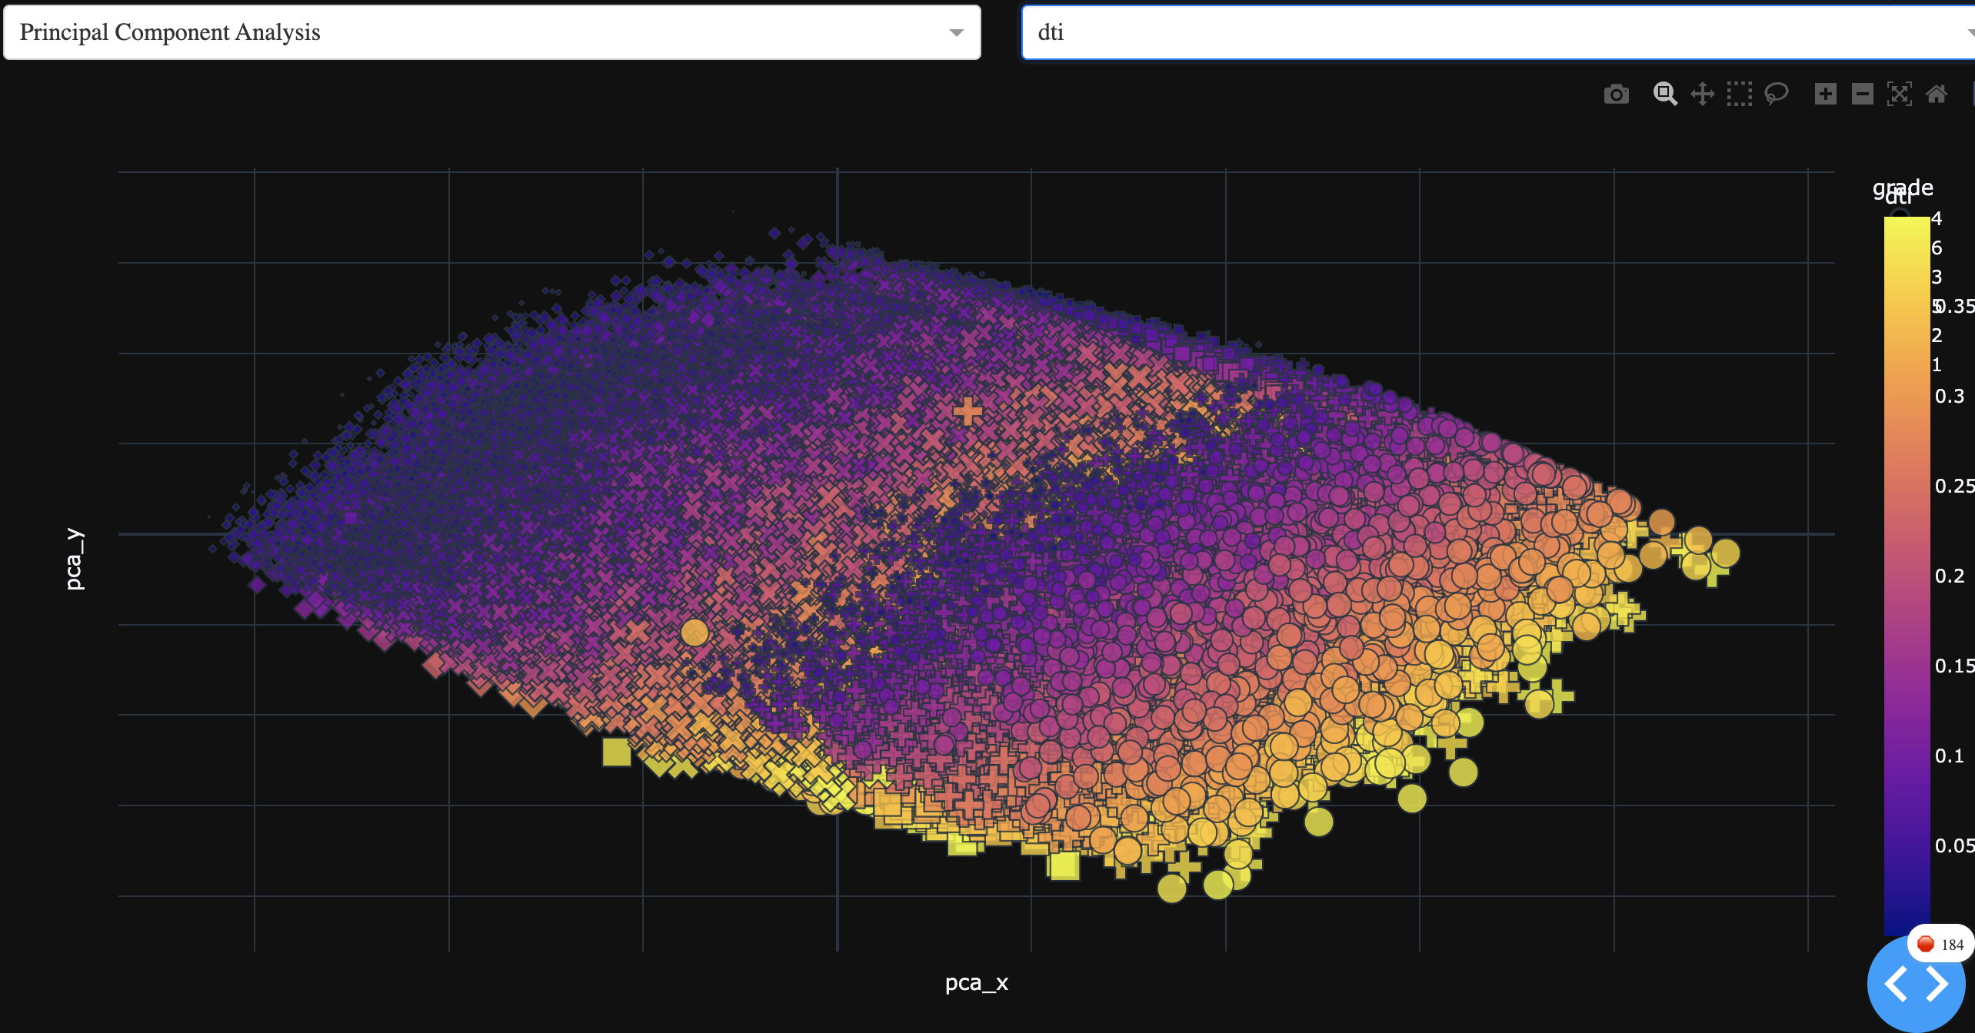
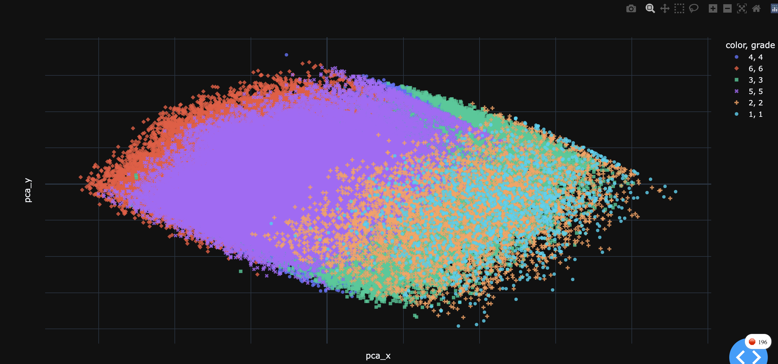
Unsupervised Learning Models
Principal Component Analysis has practical implementation to risk analytics in finance
Good way for investors to evaluate their portfolio returns
Each principal component represents the percentage return on a statistical risk factor
Investors can optimize their portfolios by adjusting weights to match risk/return
PCA Visualization

Slide 8
Feature Selection
Spearman correlation matrix is used to identify variables with the strongest correlation to the target variable “charge off.”
Logistic regression and Random Forest use these features as independent variables.
All financial information is fit to Support Vector Machine, Gradient Boosting, KNN, and Logistic Regression.
Backwards regression is used to compare feature importance of financial and categorical information.
Linear regression to predict the Net Annualized Return based on features of a portfolio.

Slide 9
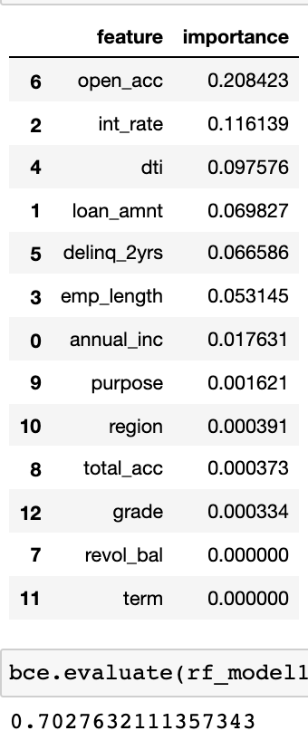
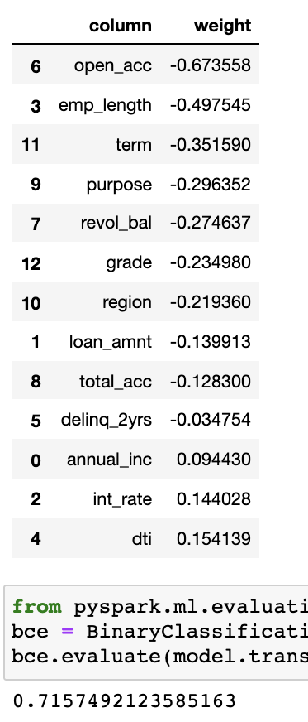
Random Forest
Logistic Regression
Notes:
Comparing logistic regression coefficients to random forest feature importances, the variable that is least likely to predict default has the highest feature importance.
The features do not help make predictions, but are a measurement of average decrease in impurity
But these features importances aren’t necessarily interpretable as helping to make predictions or allowing us to analyze the problem. These feature importances are only important in the model, as in how they contributed to the decisions of each decision tree as an ensemble of trees.
open_acc The number of open credit lines in the borrower's credit file.
int_rat Interest Rate on the loan
Dti A ratio calculated using the borrower’s total monthly debt payments on the total debt obligations, excluding mortgage and the requested LC loan, divided by the borrower’s self-reported monthly income.
loan_amnt The listed amount of the loan applied for by the borrower. If at some point in time, the credit department reduces the loan amount, then it will be reflected in this value.
Delinq_2yrs - The number of 30+ days past-due incidences of delinquency in the borrower's credit file for the past 2 years
Emp_length - Employment length in years. Possible values are between 0 and 10 where 0 means less than one year and 10 means ten or more years.
Annual_inc The self-reported annual income provided by the borrower during registration.
Total_acc The total number of credit lines currently in the borrower's credit file
Revol_bal Total credit revolving balance

Slide 10
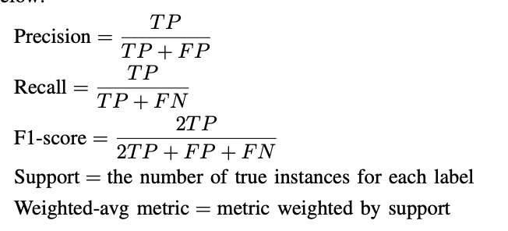
Model Evaluation
Model | Accuracy | F1 | Precision | Recall
Logistic Regression | 0.99 | 0.97 | 1.00 | 0.94
Random Forest | 0.99 | 0.97 | 0.97 | 0.96
SVM -- Linear Kernel | 0.87 | 0.53 | 1.00 | 0.36
SVM – Gaussian Kernel | 0.87 | 0.53 | 1.00 | 0.36
SVM – Polynomial Kernel | 0.84 | 0.31 | 0.99 | 0.18
Gradient Boosting | 0.99 | 0.97 | 0.94 | 1.00
KNN | 0.83 | 0.45 | 0.65 | 0.35
Notes:
Reviewing both precision and recall is useful in cases where there is an imbalance in the observations between the two classes. Specifically, there are many examples of no event (class 0) and only a few examples of an event (class 1).
The reason for this is that typically the large number of class 0 examples means we are less interested in the skill of the model at predicting class 0 correctly, e.g. high true negatives.
Key to the calculation of precision and recall is that the calculations do not make use of the true negatives. It is only concerned with the correct prediction of the minority class, class 1.

Slide 11
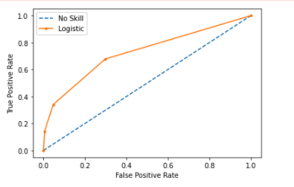
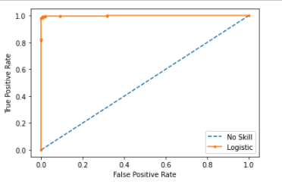
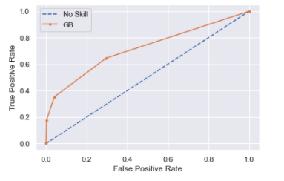
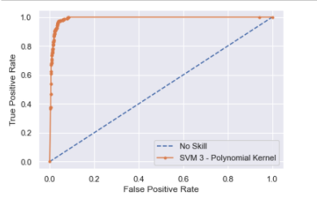
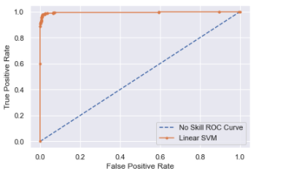
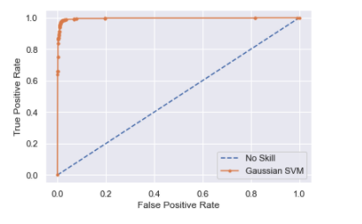
KNN
Logistic Regression
Gradient Boosting
Polynomial SVM
Gaussian SVM
Linear SVM
Notes:
Given the imbalance in the dataset, a no-skill classifier is used to measure the ratio of charged off cases and does not discriminate between the classes. The no-skill line changes based on the distribution of the positive to negative classes.
A precision-recall curve is a plot of the precision (y-axis) and the recall (x-axis) for different thresholds, much like the ROC curve.
A no-skill classifier is one that cannot discriminate between the classes and would predict a random class or a constant class in all cases. The no-skill line changes based on the distribution of the positive to negative classes.
It is a horizontal line with the value of the ratio of positive cases in the dataset. For a balanced dataset, this is 0.5.

Slide 12
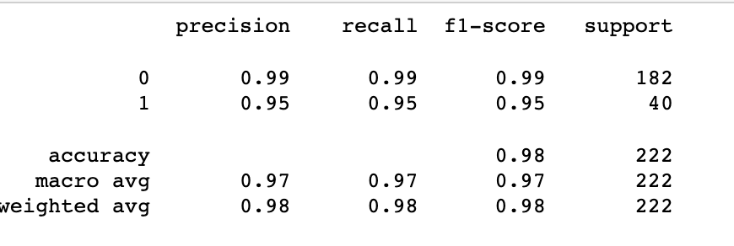
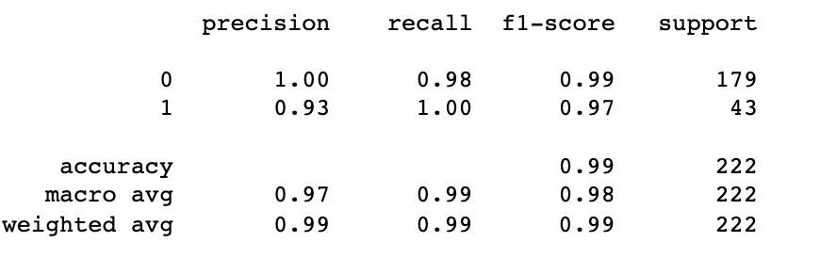
Backwards Regression
Logistic Regression with features of financial information
Logistic Regression with added demographic features state, employment title, and grade

Slide 13
The End of LendingClub
LendingClub discontinues issuing notes
2014
2018
2020
Notes:
https://topclassactions.com/lawsuit-settlements/money/loans/lendingclub-and-ftc-reach-18m-settlement-in-false-advertising-lawsuit/
https://www.bloomberg.com/opinion/articles/2016-05-11/lendingclub-s-troubles-bring-back-bad-memories

Slide 14
Challenges for AI Based Lending
Bias
Errors
Time
Ethics and privacy
Regulation
Machine learning algorithms prevent inequality and discrimination without breaching privacy regulation laws?
How can algorithms be regulated by government agencies to ensure fair lending without reducing their accuracy?
“We know that a history of racism in financial services contributed to much of the economic inequality we see today. As tech, data, and AI plays an ever larger role in delivering quality financial services, this regulation is critical to ensuring these tools don’t lead to unintended outcomes. Instead of weakening these rules, this is the moment to reaffirm our shared commitment to a financial system that is designed to promote inclusion and opportunity for all Americans.”
Notes:
https://www.americanbanker.com/news/fintechs-seek-cfpb-guidance-on-making-ai-based-lending-fair
- Machine learning algorithms prevent inequality and discrimination without breaching privacy regulation laws?
- How can algorithms be regulated by government agencies to ensure fair lending without reducing their accuracy?

